Slide 1
Design Report 1 Presentation -
Bray Embedded Valves and Actuators
Team: Avery Haynes, Locke Lehmann, Travis Carlson, Cody Sims, Zachary Walker, Michael Hager

Slide 2
Introduction

Slide 3

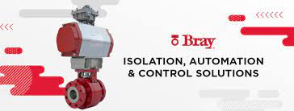
Bray
Bray is one of the world's premier manufacturers of flow control and automation products and accessories. Bray’s excellent reputation includes creating products of superior value and quality compared to competitors.

Slide 4
Our Project
This semester, our team was assigned to work with Bray to develop a method to internally measure valve position independent of an actuator, measure actuator output torque, and detect fluid leakage to increase the valve's service life.

Slide 5
Background Research

Slide 6
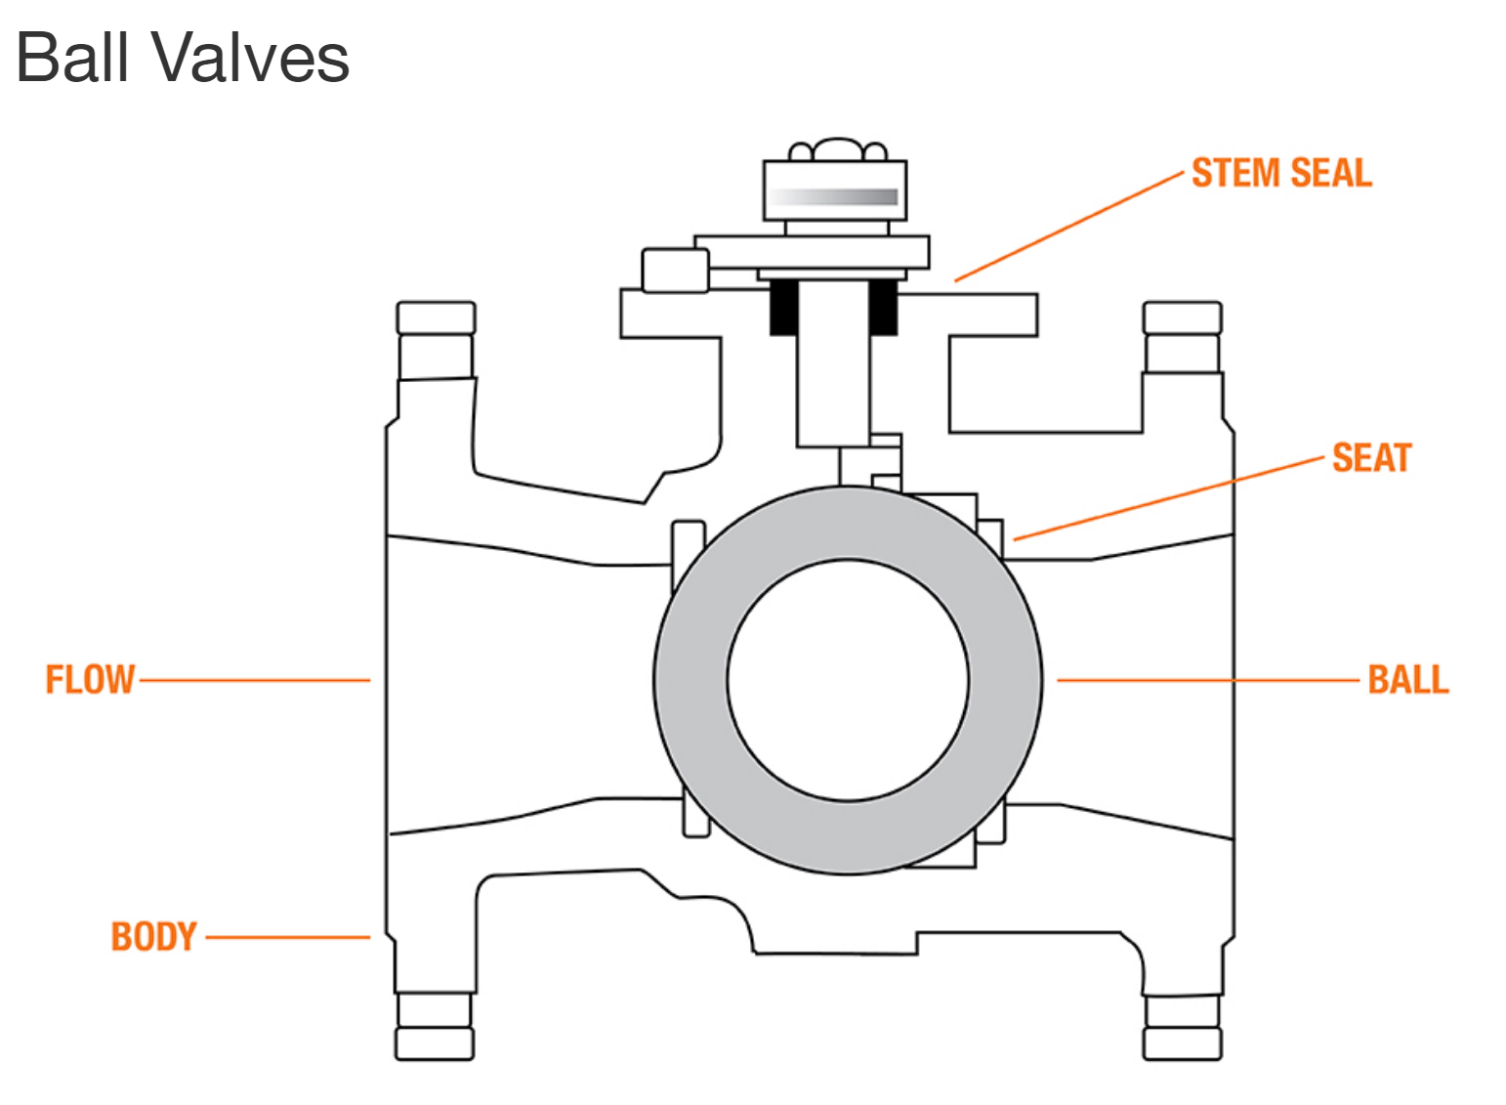
Ball Valve
Stem Seal: this connects the ball to the external control mechanism (handwheel,lever, actuator, etc.)
Rotary Ball: the ball is designed with a center bore which the medium flows through and rotates 90 degrees to block/allow the medium flow.
Body: The casing that contains all the other valve components and fits between the two pipes. There are four types of ball valve bodies: single body, split body, top entry, and welded
Seat: Ring of either metal or rubber that secures the disc in place and prevents leakage.
Flow: Direction of medium movement

Slide 7
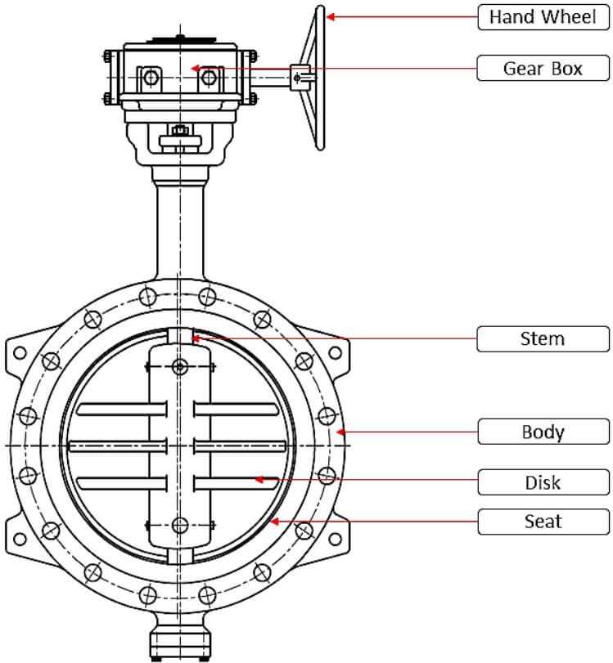
Butterfly Valve
Handwheel: a wheel that is on the outside of the valve that is turned to move the disc from parallel to perpendicular to the flow. Electrical valves use an actuator instead of a handwheel.
Gear Box: Translates motion from the handwheel or actuator into rotational motion to turn the disc.
Stem: A rod that connects the disc to the actuator. In low-end valves, the stem is sealed off from the fluid while in high-end valves the stem is in contact with the fluid.
Body: The casing that contains all the other valve components and fits between the two pipes. The valve body can be lug-type or wafer-type.
Lug type: used for end-of-line service.
Wafer type: used to connect two lines.
Disk: Circular object that acts as a gate that either allows or stops fluid flow.
Seat: Ring of either metal or rubber that secures the disc in place and prevents leakage.

Slide 8
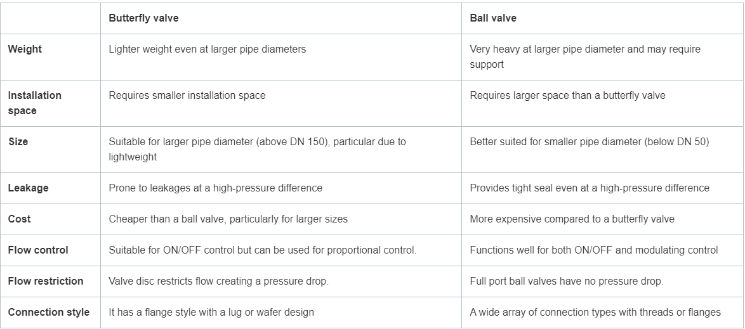
Ball Valve vs Butterfly Valve

Slide 9
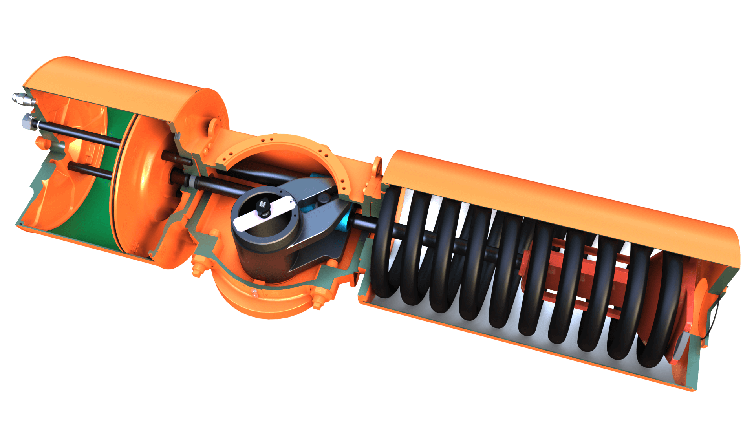
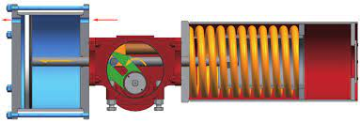
Scotch-Yoke Pneumatic Actuators
Air-operated actuator
Pressurized air drives piston along the axis of the cylinder, rotating actuator stem 90 degrees
When pressure is relieved, piston returns to its original position by a spring
Scotch yoke mechanism converts linear force into torque, allowing for the opening/closing of valves
Compatible with ball and butterfly valves
Simple and reliable devices, easy to maintain
Don’t require combustion/electricity
Adherence to safety

Slide 10
Problem

Slide 11
Solution Neutral Problem Statement
Develop a method to internally measure valve position independent of an actuator, measure actuator output torque, and detect fluid leakage to increase the service life of the valve.

Slide 12
Mission
True valve position of the body of the ball valve
Determine if there is gas leakage from the valve
Monitor the actuator torque independent of stem and body of the valve
Data will be collected and transmitted to the user to alert when the valves are showing signs of failure
All sensors must be within the valve system to make a smart device

Slide 13
Creative design & limitations
Creative design
Types of sensors
Location of sensors
Where to detect leakage
Limitations
Focus on ball valves
All sensors must be embedded to make smart device
Minimize cost of project

Slide 14
Bias
What the customer cares about:
Torque
leakage
What Bray wants as deliverables:
Actuator output torque
True valve position
Gas leakage

Slide 15
Customer Needs

Slide 16
Customer Needs Table
# | Need | Importance
1 | Final product is embedded into the actuator casing | 1
2 | Product is scalable for different sized valves | 3
3 | Product records and transmits sensor data | 1
4 | Works in a wide temperature range (-40℉-300℉) | 4
5 | Works under various pressures (100 psi - 740 psi) | 3
6 | Works for various fluid mediums | 4
7 | Measures actuator torque to < 5% error | 1
8 | Relatively short lead times for parts (3-4 weeks) | 2
9 | Detects fluid leakage from the valve system | 2
10 | Determines true valve position independent of actuator | 1
11 | Works for both pneumatic and hydraulic actuators | 3
1 being a “must”, 4 being “optional”
Needs collected during our Team’s in-person visit to Bray facilities
Importance determined by their input, feasibility to add into project, cost

Slide 17
References

Slide 18
References
https://www.dombor.com/ball-valve-vs-butterfly-valve/
https://www.rotork.com/uploads/documents-versions/24733/1/pub010-024-00_0516.pdf
https://www.bray.com/docs/default-source/brochures/product-brochures/b-1050_resilient-valves_2020_08.pdf
www.xintaivalves.com/blog/difference-between-ball-valve-and-butterfly-valve/#:~:text=Ball%20valves%20can%20handle%20high,generally%20better%20at%20regulating%20flow
redwhitevalvecorp.com/wafer-vs-lug-style-butterfly-valves/#:~:text=Lug%2DStyle%20Butterfly%20Valve,blind%20flange%20is%20always%20recommended
www.huameimachinery.com/butterfly-valves-the-ultimate-guide/.

Slide 19
Week 3 Task Updates
Deliverable | Team Member | Percent Completed | Notes
Write individual DR1 reports | All | 85% | Need to write individual DR1 reports, due on Monday 9/11
Research embedded valve sensors for ball valve | Cody | 100% | Complete ball valve research, start research on sensors
Research embedded valve sensors for butterfly valve | Locke | 100% | completed the cross sectional area, need to focus on sensors.
Visit Bray campus in Houston on 9/8 | All | 100% | Will drive down after classes on 9/8, around 1 PM

Slide 20
Week 4 Tasks
Deliverable | Team Member | Percent Completed | Notes
Complete and turn in DR1 reports | All | 85% | Need to turn in by tonight
HOQ team assignment | All | 0% | Need to complete and turn in by 9/14
Clarify scope and priorities of project with Bray | All | 25% | Dicsuss with Bray how exactly their current solutions are applied, and what the next steps are

Slide 21
Questions?

